Slide 1
Storage & Network Considerations

Slide 2
Volumes, persistent and temporary
A container file system only lives as long as the container does. When a container terminates, any data stored within the container is lost.
You must create a volume if the container needs persistent storage
Various types of data can be mounted as volume (e.g. Configmaps, Secrets, HostPath, ServiceAccount, etc.)
You can create several types of persistent storage
apiVersion: v1
kind: Pod
metadata:
name: redis
spec:
containers:
- name: redis
image: redis
volumeMounts:
- name: redis-persistent-storage
mountPath: /data/redis
volumes:
- name: redis-persistent-storage
emptyDir: {}

Slide 3
Persistent volumes and how they are created
A PersistentVolume (PV) is a piece of storage in the cluster that has been provisioned by an administrator. It is a resource in the cluster just like a node is a cluster resource. Persistent volumes can be provisioned in one of two ways:
Statically -- A cluster administrator creates a number of PVs. They carry the details of the real storage which is available for use by cluster users. They exist in the Kubernetes API and are available for consumption.
Dynamically -- When none of the static PVs the administrator created matches a user’s PersistentVolumeClaim, the cluster may try to dynamically provision a volume specially for the PVC. This provisioning is based on StorageClasses. The PVC must request a class and the administrator must have created and configured that class in order for dynamic provisioning to occur.

Slide 4
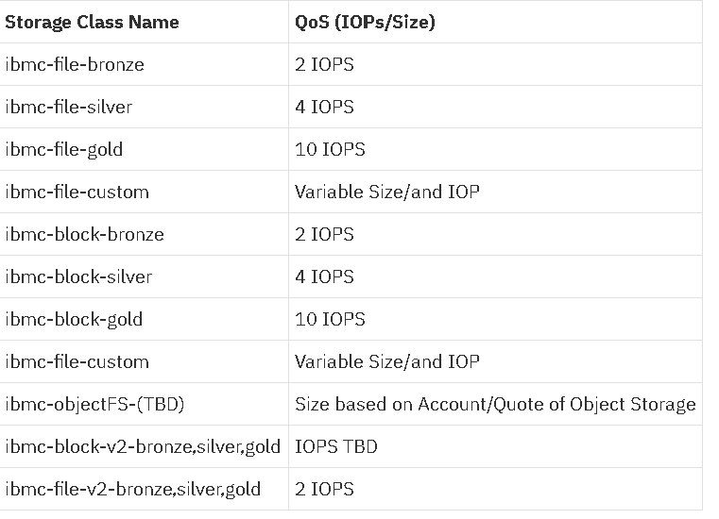
Dynamic storage provisioning
For more information, see:
https://www.ibm.com/support/knowledgecenter/SSBS6K_2.1.0/installing/storage_class_all.html
Dynamic provisioning allows storage volumes to be created on-demand.
Use storage classes to provision volumes.
Different classes has different Input/output operations per second (IOPS)
Classes should be defined prior to installing ICp
Only Kubernetes storage classes are valid
Created *.yaml files for storage classes go in the /<installation_directory>/ibm-cloud-private-2.1.0-beta/misc/storage-classes folder.

Slide 5
Supported file systems and storage
File system or storage type | Version | Notes
NFS | 4 | Both server and client must be certified version 4.
GlusterFS | 3.10.1 | Both server and client must be certified version 3.10.1.
vSphere Virtual Volume | Not applicable | vSphere cloud provider must be configured.
nodePath | Not applicable | Strongly suggested that you NEVER use this storage type

Slide 6
Network File System (NFS)
NFS only needs to be installed on the NFS server
The ability to mount NFS mount points is installed by default with ICp
The tutorial will cover a common NFS installation

Slide 7
Configuring a vSphere cloud provider
Before you begin, ensure that the nodes in your cluster meet the following requirements:
All IBM® Cloud private cluster nodes must be under one vSphere VM folder.
Node host name must be same as the VM name.
Nodes host names must comply with the regex [a-z](([-0-9a-z]+)?[0-9a-z])?(\.[a-z0-9](([-0-9a-z]+)?[0-9a-z])?)*.

Slide 8
Configuring a vSphere cloud provider (2)
Node host name must also comply with the following restrictions:
They must not begin with numbers.
They must not use capital letters.
They must not have any special characters except . and -.
They must be a minimum of 3 characters and a maximum of 63 characters long.
The disk UUID on the node VMs must be enabled: the disk.EnableUUID value must be set to True.
The user specified in the vSphere cloud configuration must have the privileges to interact with vCenter.

Slide 9
Configuring a vSphere cloud provider (3)
Fore more information, see https://www.ibm.com/support/knowledgecenter/SSBS6K_2.1.0/installing/cloud_provider_vsphere.html

Slide 10
Volume access modes
Important: A volume can only be mounted with one access mode at a time, even if the volume supports multiple access modes. For example, a GCEPersistentDisk can be mounted as ReadWriteOnce by a single node or ReadOnlyMany by many nodes, but not at the same time.
Access modes include these types:
Read-Write Once (RWO) -- The volume can be mounted by a single node for read-write operations
Read-Only Many (ROX) – Many nodes can access the volume with read-only access
Read-Write Many (RWX) – Many nodes can access the volume in read-write mode

Slide 11
Reclaiming volume resources
There are policies that reclaim resources used by volumes. Current reclaim policies are:
Retain – manual reclamation
Recycle – basic scrub (“rm -rf /thevolume/*”) – this policy only supported on NFS and HostPath
Delete
This policy removes both the PersistentVolume object from Kubernetes, and deletes the associated storage asset in the external infrastructure, such as an AWS EBS, GCE PD, Azure Disk, or Cinder volume.
This policy does not apply to NFS storage.

Slide 12
Volume phases
The CLI will show the name of the PVC bound to the PV.
Available – a free resource that is not yet bound to a claim
Bound – the volume is bound to a claim
Released – the claim has been deleted, but the resource is not yet reclaimed by the cluster
Failed – the volume has failed its automatic reclamation

Slide 13
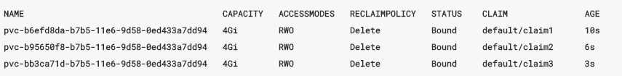
Viewing the volume status and types
kubectl get pv
The preceding command results in output like the following example.

Slide 14
Security and authentication

Slide 15
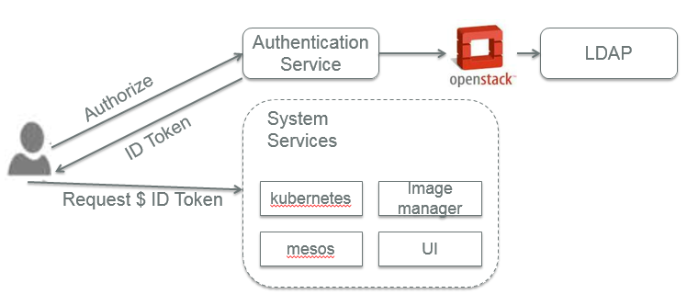
Authentication
GA version will use IBM Identity and Access Management (IAM)
Current beta version also uses OpenStack Keystone as the backend
User/Tenant management
If using LDAP, authentication information is passed through to the LDAP server
No documentation at this time for how to configure LDAP using IAM
| 15

Slide 16
Two authentication options for inter-server communications
Use passwordless SSH connection between servers
Generate SSH key on boot-master server
Share the SSH key with other servers in cluster
Configure password access between servers
See https://www.ibm.com/support/knowledgecenter/SSBS6K_2.1.0/installing/password_auth.html for more details.

Slide 17
Sharing SSH keys among cluster nodes
Secure Shell (SSH) keys are used to allow secure connections between hosts in an IBM® Cloud private cluster.
Before you install an IBM® Cloud private cluster, you configure authentication between configuration nodes.
Generate an SSH key pair on your boot node and share that key with the other cluster nodes.
To share the key with the cluster nodes, you must have the access to an account with root access for each node in your cluster.
For more information, see https://www.ibm.com/support/knowledgecenter/SSBS6K_2.1.0/installing/ssh_keys.html

Slide 18
Using passwords
Use passwords in place of SSH keys to allow for secure connections between hosts in an IBM® Cloud private cluster.
Before you install an IBM® Cloud private cluster, you configure authentication between configuration nodes. You configure password authentication by providing the password for a user in each node in the config.yaml file that is in the /<installation_directory>/cluster folder.
You must provide passwords for the root user or for user names that have root access.
Provide password information in the config.yaml file.

Slide 19
Using passwords (continued)
Sample parameters:
ansible_user: root
ansible_ssh_pass: SHARED_PASSWORD
ansible_ssh_common_args: "-oPubkeyAuthentication=no"
ansible_become and ansible_become_password
If you use a non-administrator account that has sudo privileges to connect to a master or worker node, you can set the ansible_user to the user name and ansible_become to true.
If you run sudo with a password, you must set ansible_become_password to the value of your non-root (sudo user) password
For more information on password configuration parameters, see https://www.ibm.com/support/knowledgecenter/SSBS6K_2.1.0/installing/password_auth.html

Slide 20
Proxy considerations

Slide 21
Proxy server issues
Dedicated proxy servers are required for a high availability (HA) environment:
Specify 3 - 5 hosts in the master and proxy sections of the /<installation_directory>/cluster/hosts file. For example:
[master]
<master_node_1_IP_address>
<master_node_2_IP_address>
<master_node_3_IP_address>
[worker]
<worker_node_1_IP_address>
....
[proxy]
<proxy_node_1_IP_address>
<proxy_node_2_IP_address>
<proxy_node_3_IP_address>

Slide 22
Proxy server issues (continued)
In HA environments, you can also set values for node-specific parameters in the hosts file. For example, you can set the vip_iface parameter values, as show in the following code:
[master]
<master_node_1_IP_address> vip_iface=eth0
<master_node_2_IP_address> vip_iface=ens192
<master_node_3_IP_address> vip_iface=ens160
In HA environments, these parameters configure the proxy node virtual environment:
proxy_vip_iface -- Sets the virtual IP interface (e.g. eth0) for a proxy node HA environment.
proxy_vip -- Sets the virtual IP address (e.g. 172.21.16.13) for a proxy node HA environment. Do not specify the subnet (e.g. CIDR notation).

Slide 23
Network considerations

Slide 24

Calico
Pure layer 3 cloud networking solution
Distribute routes using BGP protocol, with route reflectors for scale
Leverage Linux kernel’s efficient IP forwarding engine
Translate global policy into distributed firewall on each host, enabling tenant isolation
Calico plugin
Route reflector
Compute Node
Containers
BGP client
Felix
Linux kernel
routes
ACL
eth0
Any physical fabric (L2, L3, MPLS …)

Slide 25
Network considerations
Docker and Calico enable the configuration of networking between server components and projects running on servers
Kubernetes provides DNS service to members of the cluster and instructs containers to use its DNS service
A utility called UCarp enables two hosts to share common virtual IP address when configuring automatic failover

Slide 26
Calico networking properties in config.yaml
In the config.yaml file, the calico_ipip_enabled property allows Calico to be run on IP over IP mode.
This setting is needed when worker nodes are in different subnetworks and BGP is not enabled in routers between the worker nodes.
This setting is also needed in some cloud environment such as OpenStack, where virtual machines are not allowed to work as routers.
calico_tunnel_mtu -- The IPIP for Calico has a default MTU of 1430.
If the main interface of your host has an MTU that is less than 1450, Calico IPIP has poor performance.
Set the MTU such that the MTU of the host main interface minus the default MTU of the Calico IPIP tunnel is greater than or equal to 20.

Slide 27
Calico networking properties in config.yaml (2)
These address ranges cannot be used by Calico networking:
10.0.2.15/24 - this IP range is the default vagrant/virtualbox NAT interface address range.
92.168.122.* - this IP range is the default libvirt VM interface address range
Calico networking (network_type: calico) uses Border Gateway Protocol (BGP) for routing. (Routing between cluster and existing infrastructure requires separate configuration.)
For more information, see https://www.ibm.com/support/knowledgecenter/SSBS6K_2.1.0/installing/config_yaml.html

Slide 28
Helm and kubectl

Slide 29
Setup the Helm CLI
Kubernetes has a client-server package manager that deploys packages
Helm is the client
Tiller is the server
The version numbers must match or the package manager does not work (current version is 2.4 for both)
Instructions at https://www.ibm.com/support/knowledgecenter/SSBS6K_2.1.0/app_center/create_helm_cli.html

Slide 30
Setup the Helm CLI
Download the Helm executable binary file.
For Linux™ 64-bit, run the following command on a single line:
docker run -t --entrypoint=/bin/cp -v /usr/local/bin:/data ibmcom/helm:v2.5.0 /helm /data/
For Linux™ on Power® 64-bit LE, run the following command on one line:
docker run -t --entrypoint=/bin/cp -v /usr/local/bin:/data ppc64le/helm:v2.5.0 /helm /data/
Create a Helm home directory. Run the following command:
mkdir -p /var/lib/helm; export HELM_HOME=/var/lib/helm

Slide 31
Setup the Helm CLI (2)
Initialize the Helm CLI.
If you are connected to the internet and want to download the stable Helm repo, run the following command:
helm init --client-only
If you are not connected to the internet, run the following command:
helm init --client-only --skip-refresh
Verify that the Helm CLI initialized. Run the following command:
helm version
The output resembles the following example:
Client: &version.Version{SemVer:"v2.5.0", GitCommit:"012cb0ac1a1b2f888144ef5a67b8dab6c2d45be6", GitTreeState:"clean"}

Slide 32
The kubectl utility
The kubectl utility is the primary method of communication with the IBM Cloud Private cluster and is much more functional than the UI at this time. Though it must be installed separately, it is essential.
This utility is followed on a command line by other parameters
For example, kubectl get pv shows persistent volumes
Install this utility after completing the ICP installation:
On Linux use this command,
docker run -e LICENSE=accept --net=host -v /usr/local/bin:/data ibmcom/kubernetes:v1.7.3-ee cp /kubectl /data
On Power® 64-bit LE use this command:
docker run -e LICENSE=accept --net=host -v /usr/local/bin:/data ppc64le/kubernetes:v1.7.3-ee cp /kubectl /data

Slide 33
kubectl authentication
The information used to authenticate kubectl expires every 12 hours and the token has to be renewed.
Click arrow for drop down menu in upper left corner of the ICP GU.
Click Configure client. When you click that option, it pops up a window with all the configuration information need to use kubectl. You can paste that information into the CLI when running kubectl to run against the cluster that is for the normal user.
You only need to do this procedure if you need to maintain an authenticated session for longer than 12 hours.
To request a token that persists > 12 hours, see instructions at http://tinyurl.com/ya9hpqxo

Slide 34
Potential issues

Slide 35
Optional: Correct swap limit error
Docker users might get an error message showing that the kernel does not support a cgroup swap limit. To avoid getting this message, do the following procedure:
1. Log into Ubuntu as a user with sudo privileges
2. Edit the /etc/default/grub file
3. Set the GRUB_CMDLINE_LINUX value as follows:
GRUB_CMDLINE_LINUX="cgroup_enable=memory swapaccount=1"
4. Save and close the file
5. Update GRUB: sudo update-grub
6. Reboot the server

Slide 36
Reporting technical issues
Report issues to the #private-cloud Slack channel
Or use the URL:
https://ibm-cloudplatform.slack.com/messages/C4W8T2449
Developers monitor this channel
To discuss issues at client sites, POC testing, etc., you can read / post the #tech-cloud-private Slack channel on the IBM Cloud Platform Slack community
https://ibm-cloud.slack.com/messages/C61SD3E3E
To see current build issues or information for ICP, read the #private-cloud-dev Slack channel. This is an internal developers channel, so do not post to this channel if you are not an ICP developer.

Slide 37
Supplemental

Slide 38
vSphere VSAN

Slide 39
vSphere VSAN
In vSphere, you can create several types of volumes.
You can use create a persistent volume with a user-specified disk format.
You can create a persistent volume with a disk format on a user specified datastore.
An authorized user can also specify the datastore in the Storageclass.
The volume will be created on the datastore specified in the storage class which in this case is VSANDatastore.
The VSANDatastore field is optional. If not specified, the volume will be created on the datastore specified in the vSphere configuration file that is used to initialize the vSphere Cloud Provider.

Slide 40
vSphere VSAN (continued)
Create a persistent volume with user specified VSAN storage capabilities (including number of data stripes for redundancy)
kind: StorageClass
apiVersion: storage.k8s.io/v1beta1
metadata:
name: vsan-policy-fast
provisioner: kubernetes.io/vsphere-volume
parameters:
diskformat: thin
hostFailuresToTolerate: "1"
diskStripes: "2"
cacheReservation: "20"
datastore: VSANDatastore
Configure storage policies with key-value pairs specifying performance and availability parameters.

Slide 41
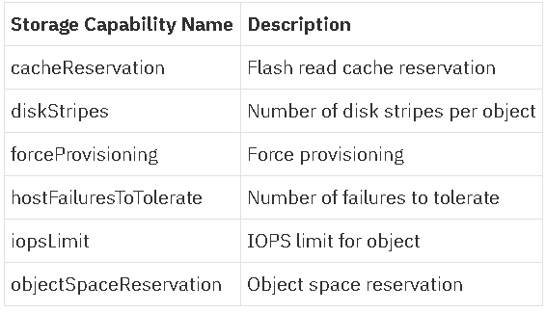
VSAN storage capabilities
Make sure to use VSAN key-value pair names when configuring ICp data storage

Slide 42
Configuring Keystone for LDAP
Beta version uses OpenStack Keystone but GA version will use IBM IAM

Slide 43
Configure LDAP
During installation, you can configure an LDAP or Active Directory (AD) connection for your IBM® Cloud private cluster.
Modify the /<installation_directory>/cluster/config.yaml file for the authentication connection.
Enable the LDAP or AD connection and set the default admin user and password for the authentication server
Configure LDAP connection to use TLS communication.
Copy all the certificate authority files to the /opt/cluster/misc/ldap/cacert/
Set the use_tls parameter to true in the misc/ldap/keystone.ldap.conf file.

Slide 44
Configure LDAP (2)
ICP does not support installing LDAP support after installation. If you want to use LDAP authentication for your ICP environment you must configure it at install time.
IBM Cloud Private uses OpenStack Keystone as its Role Based Access Control (RBAC) provider. (*Could change in future releases.)
OpenStack documentation for the identity service (Keystone) can be found at https://docs.openstack.org/mitaka/config-reference/identity/options.html. It is these options that we will use to configure LDAP integration with ICP.
For more information on parameters in config.yaml for LDAP, see: https://www.ibm.com/support/knowledgecenter/SSBS6K_2.1.0/installing/configure_ldap.html

Slide 45
LDAP Minimal installation
To enable LDAP authentication you must first modify the config.yaml and add the following lines:
ldap_enabled: true
default_admin_user: cfcadmin
default_admin_password: password
ldap_enabled -- instructs ICP to authenticate via LDAP.
The default_admin_user is the valid user in the LDAP database which should be used for the admin user in ICP.
The default_admin_password value is the password of the above named admin user.

Slide 46
LDAP minimal installation (continued)
The minimal install does not do filtering and when complete will import all users it finds and make them all available to be assigned to a namespace. If your organization has 10,000 users, you may not want this result.

Slide 47
Limiting the scope of LDAP import
To limit the users who are sync’d with keystone use the user_filter keyword in the keystone.ldap.conf file:
query_scope = sub (tells keystone to search all subtrees)
user_filter = (memberOf=CN=CfCUsers,CN=Users,DC=csplab,DC=local)
The value of user_filter is an LDAP search term which returns a list of users in a specified group – in this case a group named “CfCUsers” in the “CN=Users,DC=csplab,DC=local” subtree.
Any user added to the LDAP group results in that user immediately being available for assignment to a namespace.
If your filter is too restrictive you might have too few or no users who are able to successfully authenticate once the installation is complete.
Notes:
If ICP is installed without LDAP support, the default admin userid is “admin” and the default password is “admin”. These values in the config.yaml file will replace those and be placed in the default namespace. It is these values that you should use for your first post-installation login.

Slide 48
LDAP troubleshooting and best practices
There will be more material on LDAP best practices later this week.
For more information on LDAP configuration and troubleshooting, see the following link: https://github.com/ibm-cloud-architecture/refarch-privatecloud/blob/master/ICP%20LDAP%20Best%20Practices.md

Slide 49
This presentation is intended for an IBM internal audience only.

